Slide 1
SMART HEALTH
DISEASE PREDICTION
AI BASED POCKET DOCTOR
NAME :
SHOBHIT ARYAN LAL
HIMANSHU DUBEY
18BCS1099
18BCS1160
CLASS: K2G2

Slide 2
TABLE OF CONTENTS
01
04
Now And Future
About the Project
02
05
Snapshots
Major Requirements
03
06
Project Stages
Our Team
Brief description on current and future versions
A brief description of the project
Screenshots of the website and code
Tools and technologies required
The team behind successful completion
Multiple stages in which project completed

Slide 3
MedHacks
MEDHACKS
Smart Health disease prediction website with reliable contents on various medical treatments, medicines, diseases and tests.

Slide 4
ABOUT THE PROJECT
AI driven website which will help you to diagnose and predict the most probable disease on the basis of the symptoms. Comprehensive guide on various diseases, medicines, tests and procedures with advance searching techniques makes the layout user-friendly.

Slide 5
.
GET MOST PROBABLE DISEASE NAME ALONG WITH PREVENTIVE MEASURES, SUGGESTIONS AND MEDICATIONS

Slide 6
MAJOR REQUIREMENTS
CONCEPTS
PROGRAMMING LANGUAGES
TOOLS
Naïve Bayes Algorithm
Python
HTML
CSS
Javascript
Jupyter NoteBook
Pycharm
VS Code
Browser

Slide 7
PROJECT STAGES
STEP 2
STEP 1
STEP 3
Finding trustable and suitable datasets, Pre-processing of dataset, Implementation of Naïve Bayes algorithm, Hyperparameter Tuning, Improving performance metrics, Pickling the model
Literature Survey, Research Paper Analysis, Machine Learning Algorithms Study, SRS doumentation
Deployment of model, Building website design, Implementation of website, Linking model with website using Flask, Debugging the codes.

Slide 8
WHAT WE ARE WORKING ON
OPTIMIZED
ACCESSIBLE
FAST AND RELIABLE
Very optimised and efficient algorithm runs behind for best outcome.
Easy to use layout provides the predicted disease within seconds.
Used data from trusted sources and built model with good performance and will help in early diagnosis

Slide 9
NOW
USER-FRIENDLY DESIGN
RELIABLE PREDICTION
MEDICAL SUGGESTIONS

Slide 10
FUTURE
PATIENT HEALTH TRACKING
LIVE CONNECTIVITY WITH DOCTORS
ANDROID VERSION COMING SOON

Slide 11
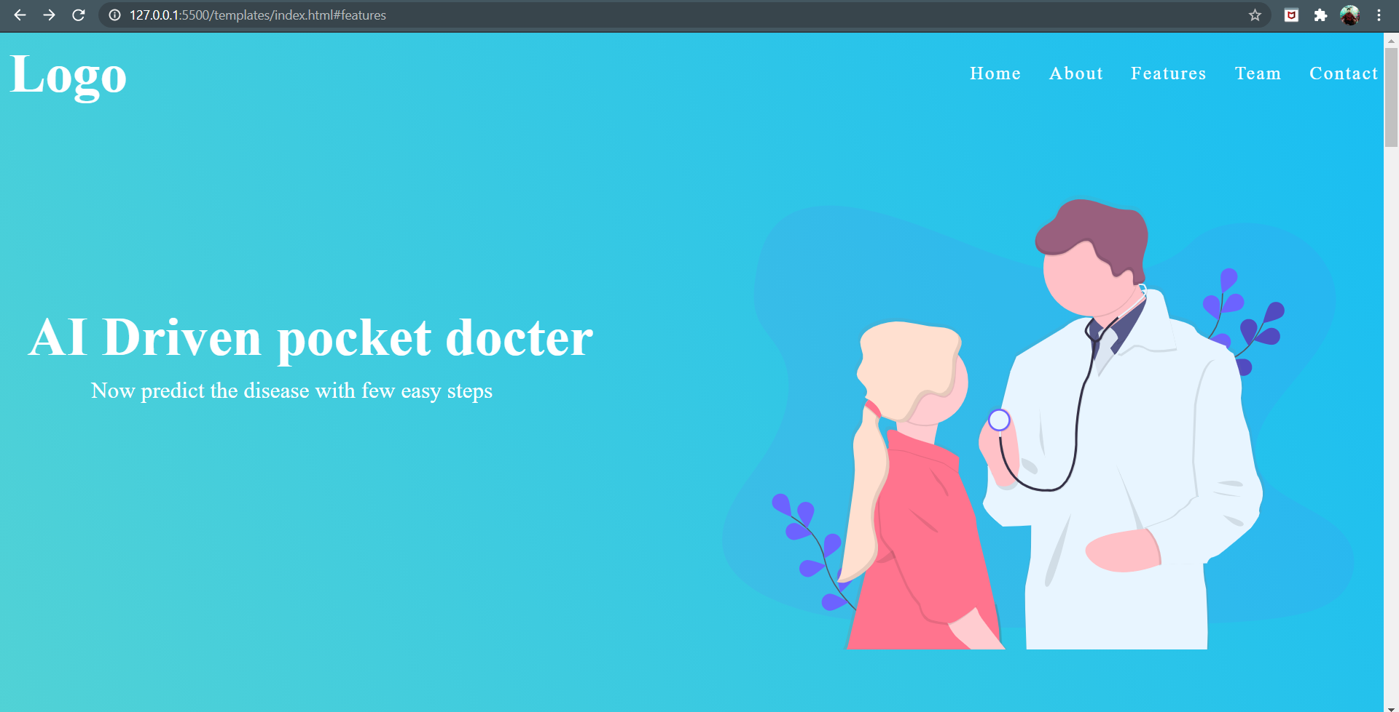
SNAPSHOTS

Slide 12
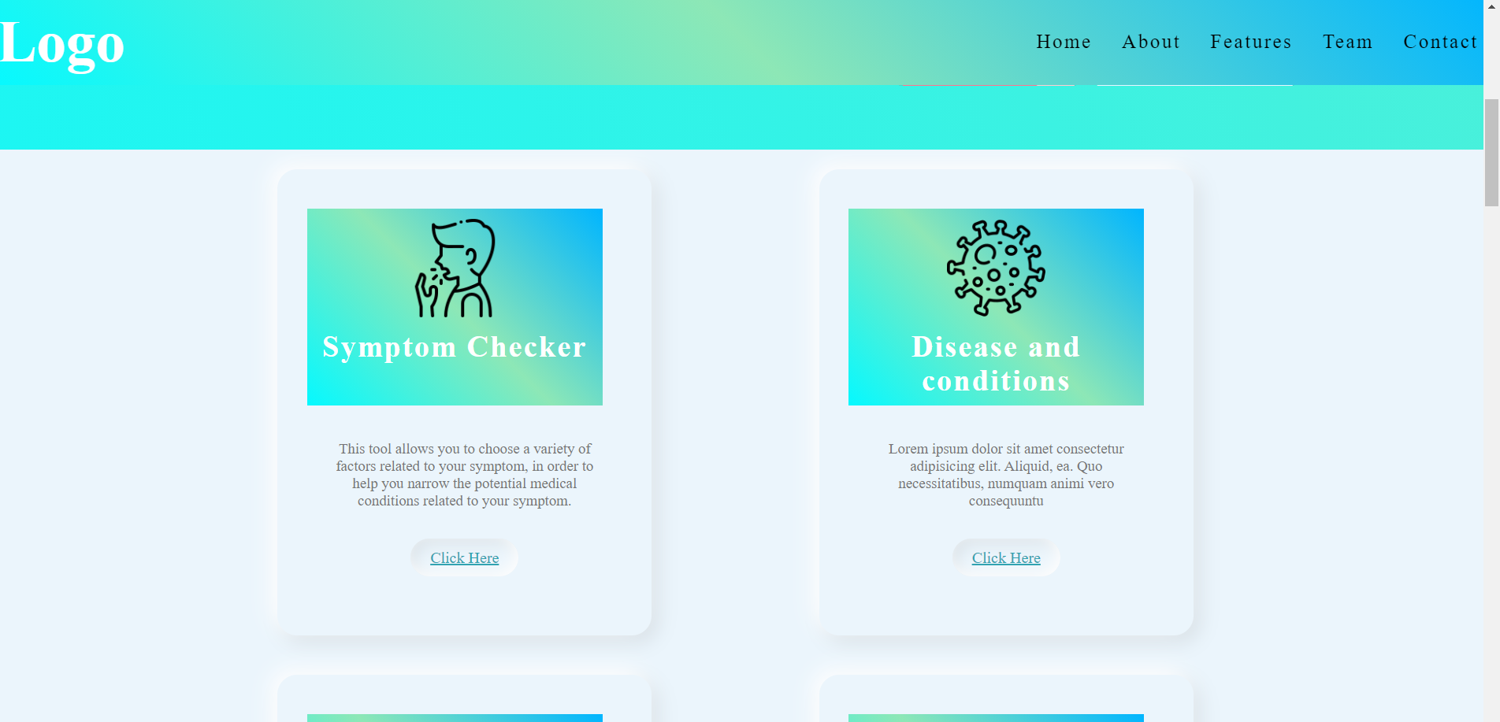
SNAPSHOTS

Slide 13
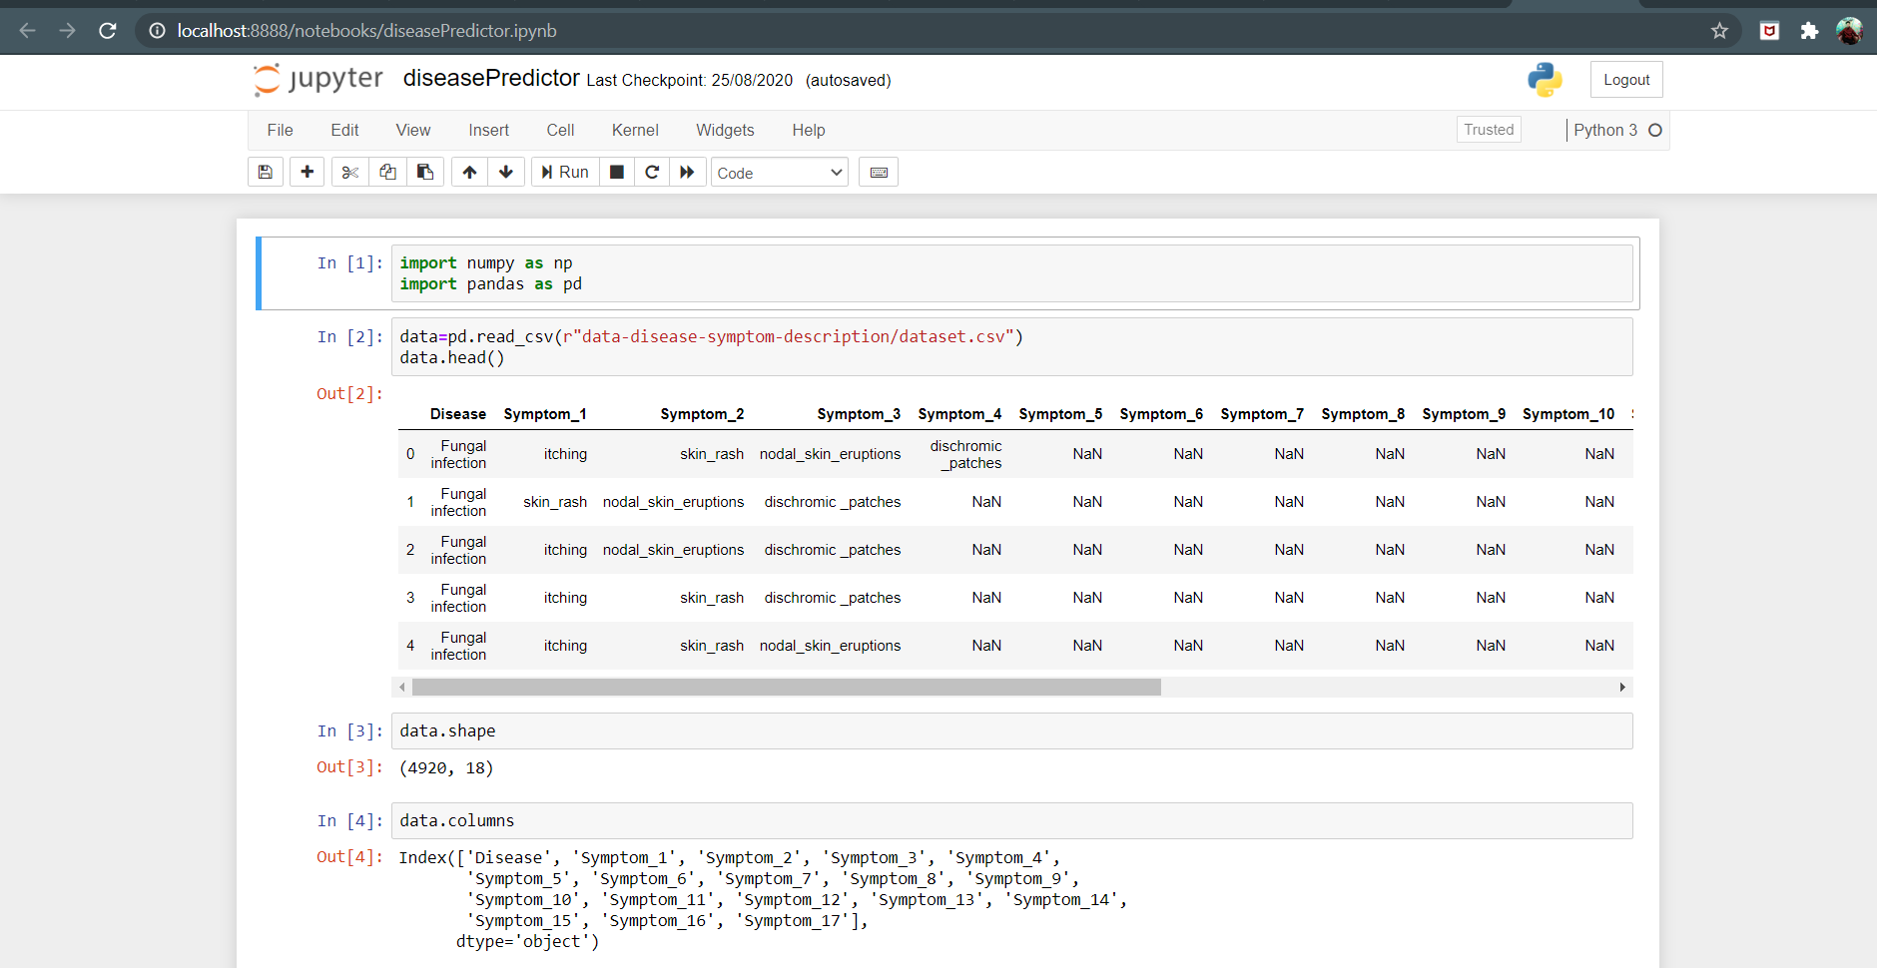
SNAPSHOTS

Slide 14
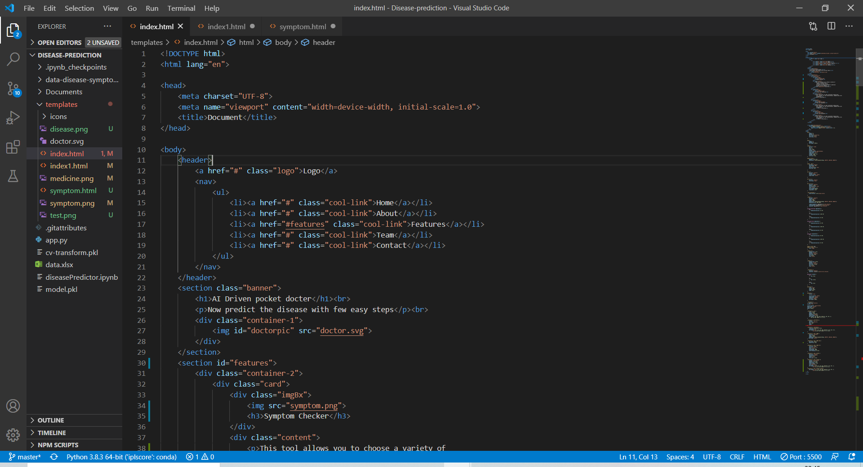
SNAPSHOTS

Slide 15
THE TEAM
Shobhit Aryan Lal – 18BCS1099 Machine Learning Developer UI – UX Designer Web Developer
Himanshu Dubey – 18BCS1160
Research Analyst
Technical Content Writer
Android Developer

Slide 16
THANKS!

